Slide 1
Stock price analysis of the past to predict the future.
By
Ashwini, Ope, Amy, Jaejun, and Gayatri

Slide 2
Analysis and Findings:
We analyzed: FAANGG for Period: January 1,2017 - December 31,2017
Apple(AAPL)
Amazon(AMZN)
Facebook(FB)
Google(GOOG)
Netflix(NFLX) and
Gold(GLD)

Slide 3
Hypothesis: Future stock prices can be predicted from past performance.
Questions considered:
What is the everyday price-change?
What’s the change in stock’s price, and daily return average over time?
Is there any correlation between daily returns of different stocks?
How much value do we put at risk by investing in a particular stock?
How to determine the trend of the stock-price and predict the future?
How do we predict the future price?
Does Twitter have any correlation with the stock market trend?

Slide 4
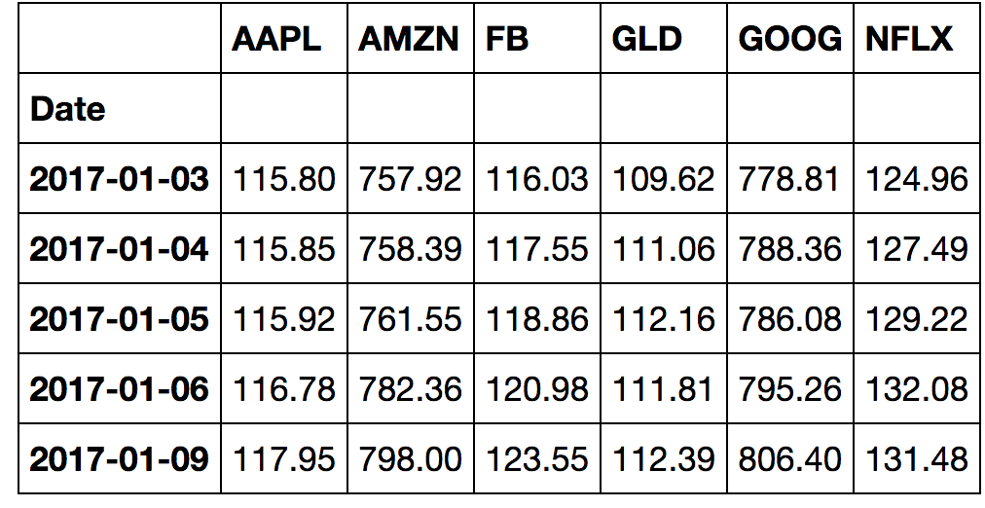
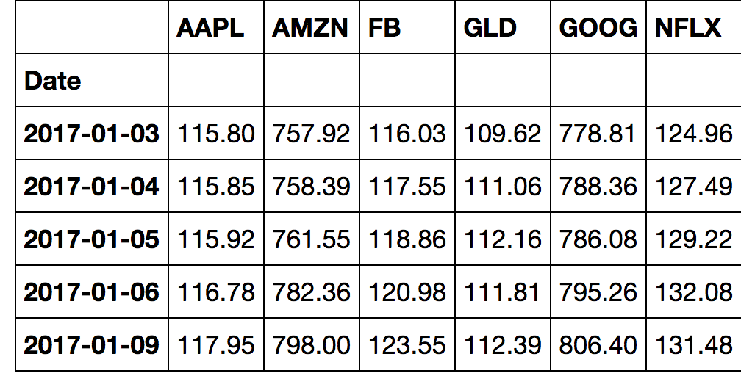
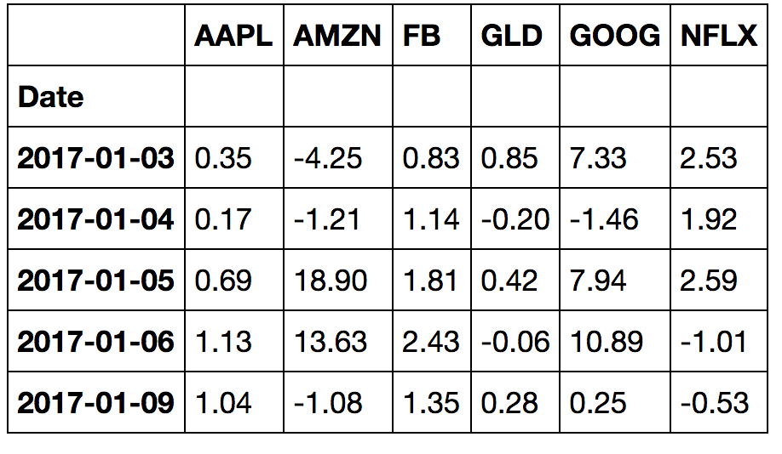
Daily Changes
Opening Price
Closing Prices
Daily Changes
Notes:
These are Opening, Closing prices

Slide 5
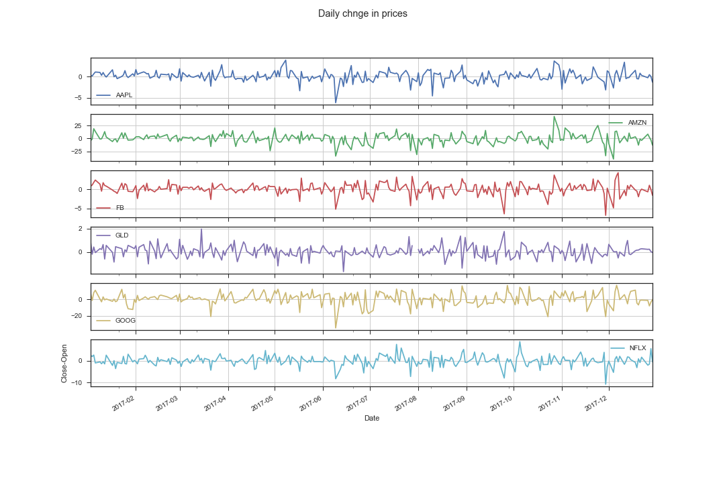
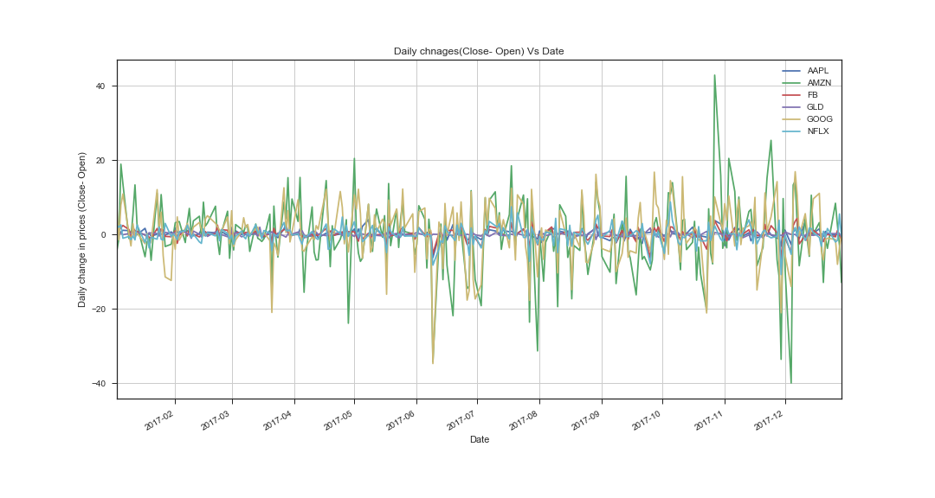
Plots/subplots: Change in prices Vs Date
Conclusion: From the graph, we noticed that Google and Amazon stocks are fluctuates a lot. Amazon goes 40 points higher in the month of Nov2017 and goes down in 40 points in Dec.

Slide 6
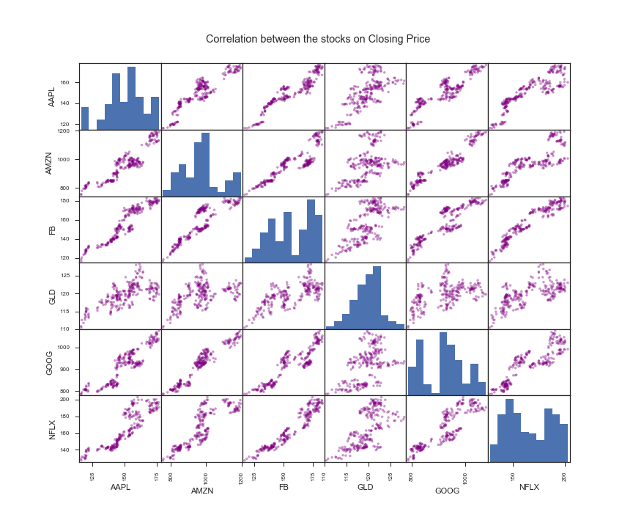
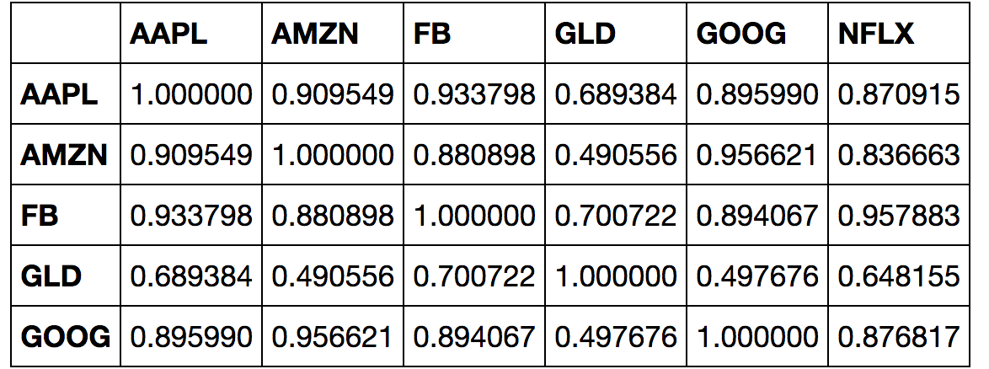
Correlation–coefficient table of closing price for all stocks:
All tech-stocks are strongly correlated to each other.
Gold(GLD) is relatively weakly correlated.
( Check out the table above and the next slid)
Hence GLD stock is one of the recommendations to have diversified well balanced portfolio.
Notes:
On this slide we can see the correlation-coefficient for all stocks.
From the matrix, it is pretty clear that the Closing Prices of the stocks do depend on one another.
i.e all tech stocks are more or less positively correlated to each other
FB prices are strongly positively correlated to AAPL,AMZN,GOOG and NFXL, except GLD.
In fact, whereas the Gold(GLD) prices are not getting affected by the prices of the other Tech stocks.
This indicates that there is a weak correlation between GLD and other stocks in the list. Take a close look at it on next slid.

Slide 7
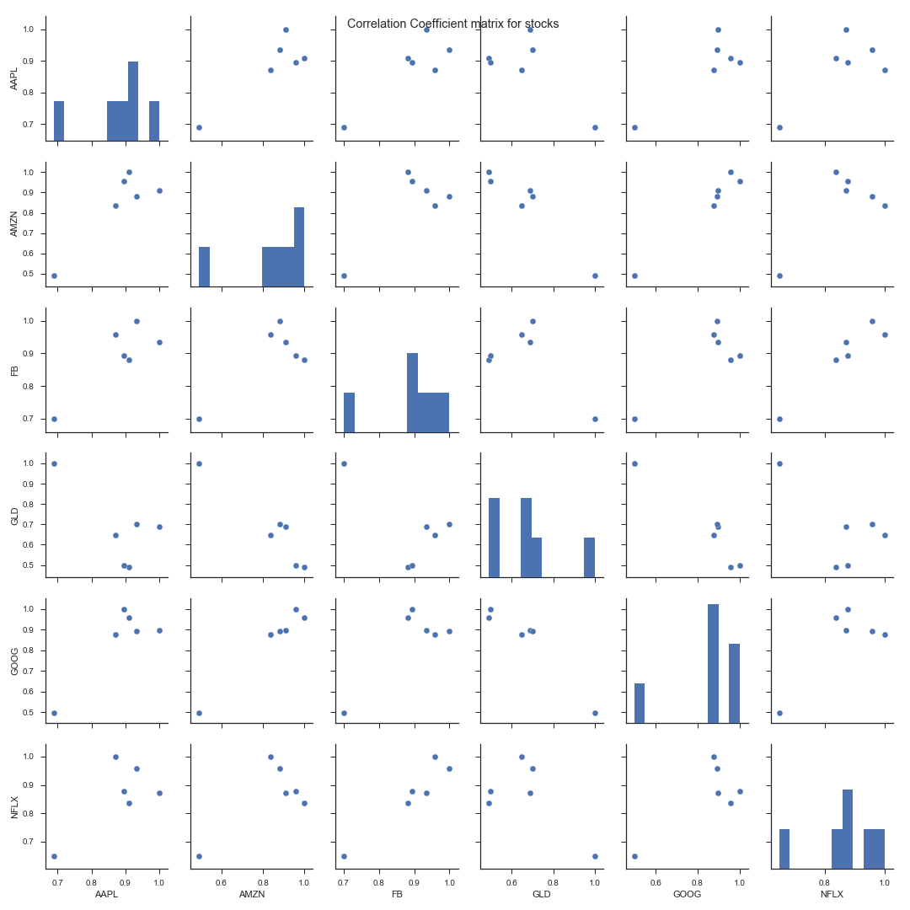
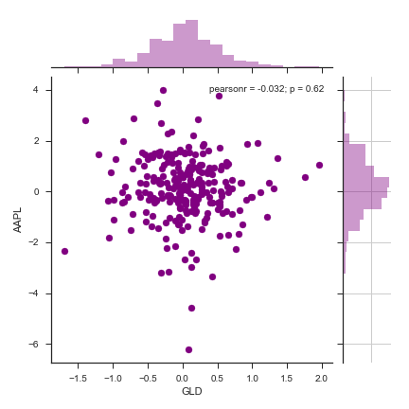
Correlation and Correlation -coefficient matrix for stocks:
Correlation-coefficient matrix
Pearson r = -0.032, p = 0.62
Low p-value Strong correlation and vice-versa.
GLD is weakly correlated to AAPL( p-value is high)
Notes:
Why buying a Gold stock is recommended?
So, buying GLD stocks will be a good idea to have diversified well-balanced portfolio.
Pearson r = -o.032, p = 0.62
(GLD is negatively correlated to AAPL)
p is the corr-coeff’s probability that the relationship between two variables is zero.
Strong relationship low p-values
See here. P =0.62. That indicates that there is very weak corr.

Slide 8
Value at Risk:
“Value at Risk:” Measure of the Risk of loss for an investment.
Estimates how much a set of investments might loose in a set time period in normal market conditions.
Value put at risk by investing in a particular stock:
Calculated by comparing its expected return with the standard deviation of daily returns.
Expected return = Mean of stock’s daily returns.
Notes:
So, let’s look at risk calculations for these stocks.
So, what is value at risk? It’s the measure of the Risk of loss for an investment. It estimates how much a set of investment might loose in a set time period in normal market conditions.
How much value do we put at risk by investing in a particular stock??
We will use various functions of pandas.

Slide 9
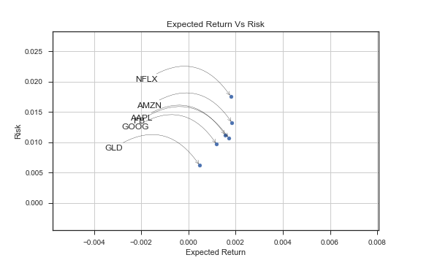
Risk Analysis:
We want high return, low risk stocks.
GLD has the lowest risk.
In the tech industry, GOOG has the lowest risk and return.
NFLX has the highest return with highest risk.
Risk and returns for FB and AAPL are almost the same.
Notes:
“GOOG is the low risk low return among tech stocks.” This sounds counter intuitive, but, this is only relative to the stocks we have analyzed.☺

Slide 10
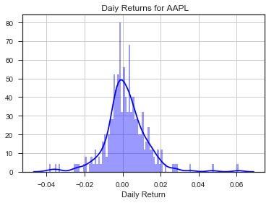
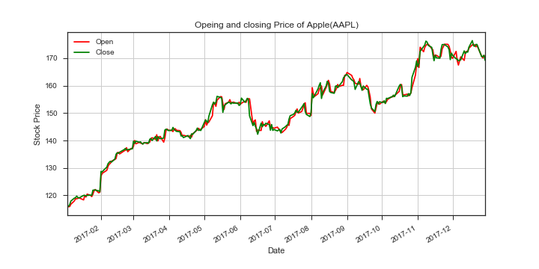
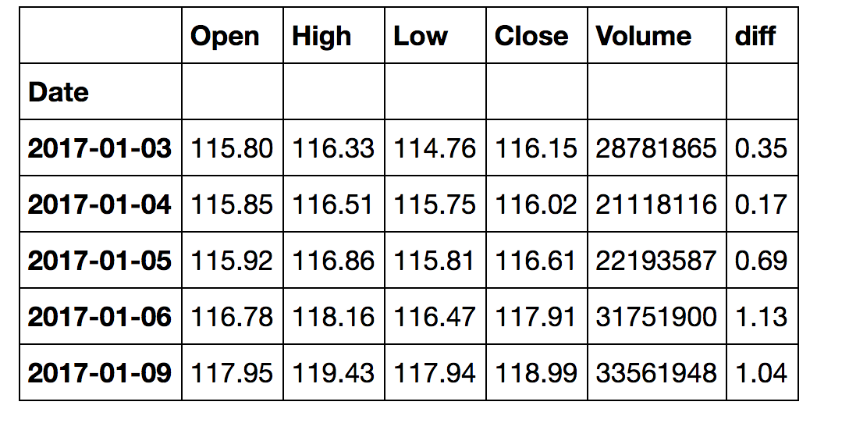
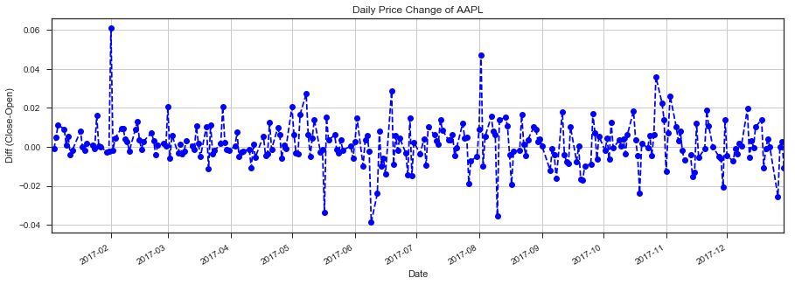
Analysis of AAPL stock
Notes:
Now we will analyze the individual stock. We have done it for Apple, and, the the process will be the same for the rest of the stock.

Slide 11
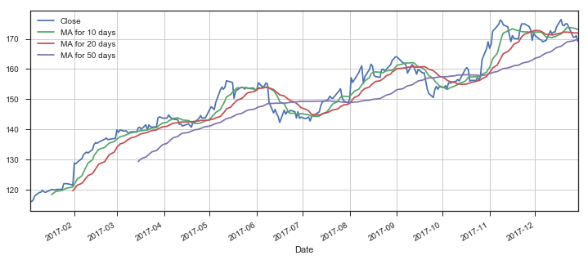
Moving Averages for AAPL:
Conclusion:
10-day and 20-day MA shows,
The Predicted price is very close to the Actual closing price of AAPL
Check:
Notes:
Moving average is the technique to get an overall idea of the trend in the data set.
It is extremely useful in forecasting the long-term trend.
So, according to this table, the predicted closing price for the AAPL is 173.816, 173.816, 173.816 respectively depending which MA we consider.
Now let’s see if our predictions are true.

Slide 12
Twitter Sentimental Analysis for Stock Market
Goal:
Analyze price change in stocks over a time period
Collect and determine tweet polarity over the same period
Tweet Filter
VaderSentiment
Determine if tweet polarity affects stock price change
Is there any correlation?

Slide 13
Snippet of code:
We will find the Moving averages for Apple
AAPL_stocks_data = web.DataReader("AAPL", "google", start, end) AAPL_stocks_data.reset_index() AAPL_stocks_data["diff"]= AAPL_stocks_data["Close"]-AAPL_stocks_data["Open"] AAPL_stocks_data.head()
ma_day = [10,20,50] for ma in ma_day: column_name = "MA for %s days" %(str(ma)) AAPL_stocks_data[column_name] = AAPL_stocks_data['Close'].rolling(window=ma,center=False).mean()
AAPL_stocks_data[['Close','MA for 10 days','MA for 20 days','MA for 50 days']].plot(subplots=False,figsize=(12,5),grid = True) plt.savefig("aaaplmoveavg.png") plt.show()

Slide 14
Twitter Sentimental Analysis for Stock Market
Goal:
Analyze Price change in stocks over a time period
Collect and determine tweet polarity over the same period
Tweet Filter
VaderSentiment
Determine if tweet polarity affects stock price change
Is there any correlation?

Slide 15
Tech Stocks
Symbol | Price Change (%) | Compound
AAPL | 2.02 | 0.2771
AMZN | 2.31 | 0.2927
FB | 2.83 | 0.1286
GOOG | 4.95 | 0.2033
NFLX | 1.89 | 0.0204
Table 1: AAPL =Apple, AMZN = Amazon,
FB = Facebook, GOOG = Google (Alphabet),
NFLX = Netflix
There was very weak positive correlation between stock price change and tweet polarity (corr = 0.11)

Slide 16
Pharma Stocks
Symbol | Price Change (%) | Compound
BMY | 4.13 | -0.1702
CELG | 3.39 | -0.1702
JNJ | 4.31 | 0.0000
MRK | 1.81 | 0.0433
PFE | 2.78 | -0.1277
Table 2: BMY = Bristol-Myers Squibb,
CELG = Celgene, JNJ = Johnson & Johnson,
MRK = Merck, PFE = Pfizer
There was weak negative correlation between stock price change and tweet polarity (corr = -0.39)

Slide 17
Twitter Sentimental Analysis for Stock Market
Using twitter alone to predict stock market trend may not be the best approach
However, it may be used as one of many sources to cross-validate
Stock price change due to people’s emotion
Analyst reports or authentic news reports may be more valid sources
Limitations of our data
Only handful of tech and biotech stocks
Only big stocks with large market cap
Narrow limited date range
Tweeter API available for only past 7 days
Multiple days
Intra day data may be a better predictor

Slide 18
Data Exploration and Clean-up :
Problems faced towards the end:
The data was working perfectly fine until the couple of days prior to the presentation.
Google Finance API started throwing errors for the “high volume of automated queries” towards the end of the project.
This resulted in not being able to complete Risk Analysis and Monte Carlo Simulation for Apple stock.
The data we got was pretty clean.
Notes:
All rows and columns have data, and, we didn’t have to clean it.
We wanted to analyzed these 5 stocks, and, analyze the APPL stock in detail using two methods: Moving Averages and Monte Carlo Analysis
Retrieving the data working fine until yesterday. Just one or two last additional tasks were left to do.
That’s when Google finance suddenly stopped cooperating.
There was a notice of Google Finance API started throwing errors for the “high volume of automated queries” towards the end of the project.
As a result of that I couldn’t retrieve the data for AAPLE.
I tried doing it using csv file, but some of the functions e.g df.pct_change() was not working.
The code for Moving Average was done earlier, but, I felt bad that we couldn’t complete the Monte Carlo Simulation and Risk Analysis for AAPL due to this issue.
Luckily, we the code uploaded on the repo. So we could make the slides for today’s presentation..☺

Slide 19
Challenges using twitter
Initial problems
StockTwits API
Not easy to get, only assigned to approved developers
Can take days
Twitter
Twitter API data can only be obtained for the past 7 days (free version)
Therefore, analyzing old stock market data with twitter was challenging

Slide 20
Conclusion:
Based on our analysis, the hypothesis that future stock prices can be predicted from past performance is true.
There was negative correlation between Stock Price change & Tweet polarity.
This suggests, Twitter may not be the best approach to predict stock market trends.

